Slide 1
Time series clustering
ECML/PKDD 2024 Tutorial
Group time series that are similar into the same cluster
Keep dissimilar series in different clusters

Slide 2
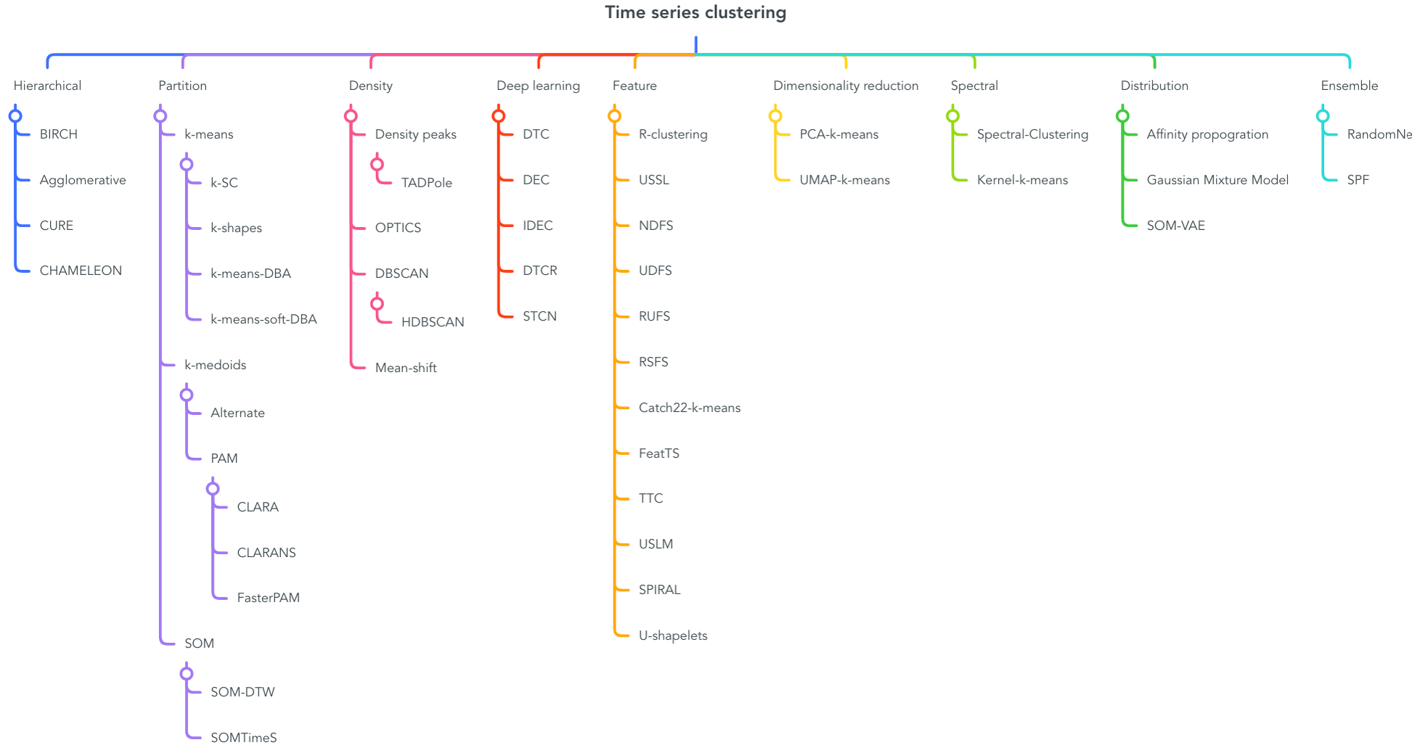
Most TSCL algorithms either:
use deep learning;
derive a set of features, then cluster them with a standard clusterer; or
define a time series specific similarity measure, then use that
This section of the tutorial focusses on partitional clustering using elastic distances

Slide 3
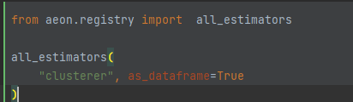

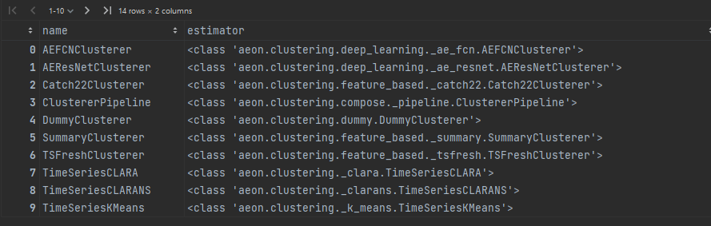
Time Series Clustering in aeon
Deep learning clusterers
(see later). More coming, current GSoC project
https://medium.com/@aadyachinubhai
Feature based pipeline
clusterers (not published)
Distance based clusterers
tslearn wrappers
3

Slide 4
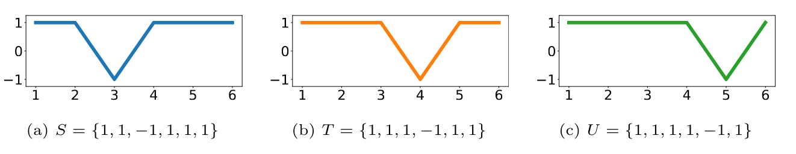
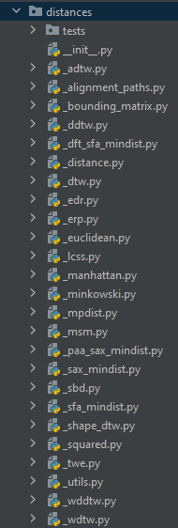
Similarity assessment is foundational
Underpins
Classification
Regression
Clustering
Anomaly & outlier detection
Sequence alignment
Recommender Systems
Feature extraction
Information retrieval
4

Slide 5


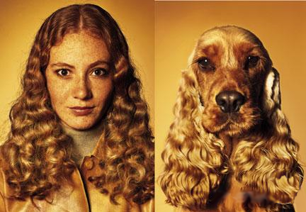
Similarity between things
similarity can be subjective and hard to define
Sometimes it’s easy to describe similarity:
Sometimes similarity is more difficult to describe…
Similarity is measured by a distance function that takes two objects and returns a scalar, the inverse of which measures similarity

Slide 6
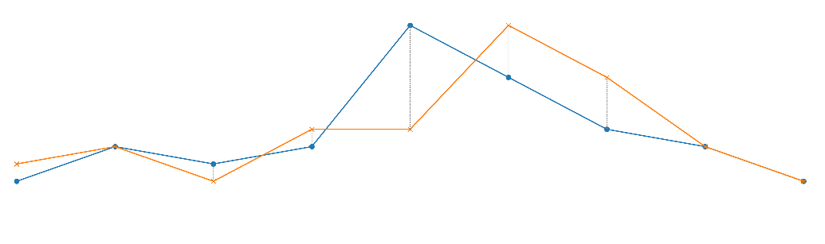
Similarity between time series
Given two time series:
x = x₁…x_{n}
y = y₁…y_{n}
The Euclidean Distance is defined as

Slide 7
Other distances for continuous variables
The Minkowski metric (a generalisation of Euclidean Distance)
If n=1, this is referred to as the Manhattan metric.
Correlation Distance
You could shuffle indexes and all of these distances would be the same

Slide 8
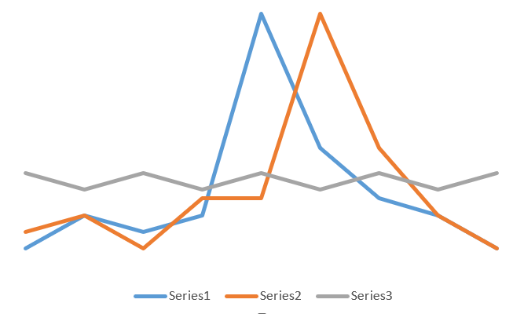
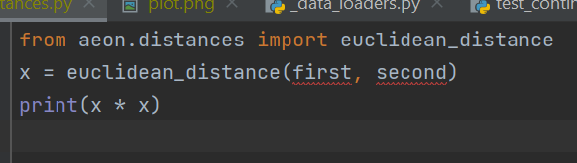
Need for elastic distances
Is series 1 more like series 2 or series 3?
ed_dist(s1, s2) = 14.03 ed_dist(s1, s3) = 12.58

Slide 9
Need for elastic distances
 | 2 | 3 | 1 | 4 | 4 | 15 | 7 | 3 | 1
1 | 1 | 4 | 0 | 9 | 9 | 196 | 36 | 4 | 0
3 | 1 | 0 | 4 | 1 | 1 | 144 | 16 | 0 | 4
2 | 0 | 1 | 1 | 4 | 4 | 169 | 25 | 1 | 1
3 | 1 | 0 | 4 | 1 | 1 | 144 | 16 | 0 | 4
15 | 169 | 144 | 196 | 121 | 121 | 0 | 64 | 144 | 196
7 | 25 | 16 | 36 | 9 | 9 | 64 | 0 | 16 | 36
4 | 4 | 1 | 9 | 0 | 0 | 121 | 9 | 1 | 9
3 | 1 | 0 | 4 | 1 | 1 | 144 | 16 | 0 | 4
1 | 1 | 4 | 0 | 9 | 9 | 196 | 36 | 4 | 0
Pointwise distance between series, called M

Slide 10
Need for elastic distances
The series are similar if we think the offset is not important.
This path has a distance of 5, compared to 57 for squared Euclidean
What if we could “warp” the series to realign the peaks?
 | 2 | 3 | 1 | 4 | 4 | 15 | 7 | 3 | 1
1 | 1 | 4 | 0 | 9 | 9 | 196 | 36 | 4 | 0
3 | 1 | 0 | 4 | 1 | 1 | 144 | 16 | 0 | 4
2 | 0 | 1 | 1 | 4 | 4 | 169 | 25 | 1 | 1
3 | 1 | 0 | 4 | 1 | 1 | 144 | 16 | 0 | 4
15 | 169 | 144 | 196 | 121 | 121 | 0 | 64 | 144 | 196
7 | 25 | 16 | 36 | 9 | 9 | 64 | 0 | 16 | 36
4 | 4 | 1 | 9 | 0 | 0 | 121 | 9 | 1 | 9
3 | 1 | 0 | 4 | 1 | 1 | 144 | 16 | 0 | 4
1 | 1 | 4 | 0 | 9 | 9 | 196 | 36 | 4 | 0
This is dynamic time warping

Slide 11
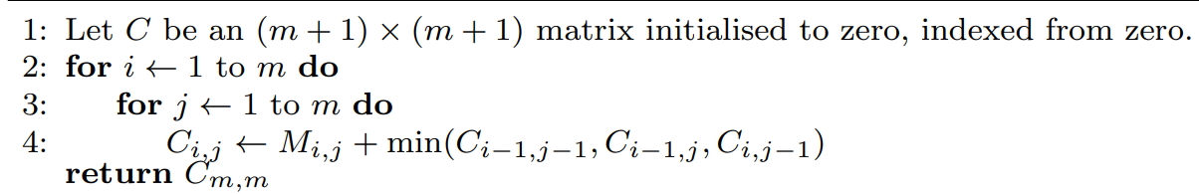
Dynamic time warping
DTW finds the path through the pointwise distance matrix that minimizes the total distance
 | 2 | 3 | 1 | 4 | 4
1 | 1 | 4 | 0 | 9 | 9
3 | 1 | 0 | 4 | 1 | 1
2 | 0 | 1 | 1 | 4 | 4
3 | 1 | 0 | 4 | 1 | 1
15 | 169 | 144 | 196 | 121 | 169
 | 2 | 3 | 1 | 4 | 4
1 | 1 | 5 | 5 | 14 | 23
3 | 1 | 1 | 5 | 6 | 7
2 | 1 | 2 | 3 | 7 | 10
3 | 1 | 2 | 6 | 4 | 5
15 | 170 | 145 | 198 | 122 | 173
M=
C=

Slide 12
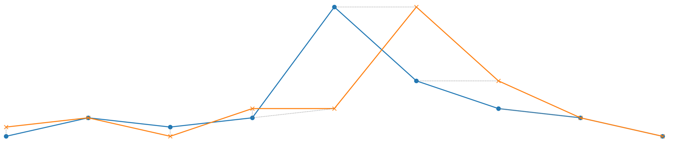
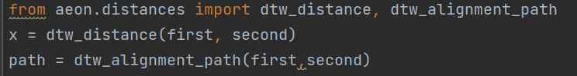
dtw_dist(s1, s2) = 5.0 dtw_dist(s1, s3) = 151.0

Slide 13
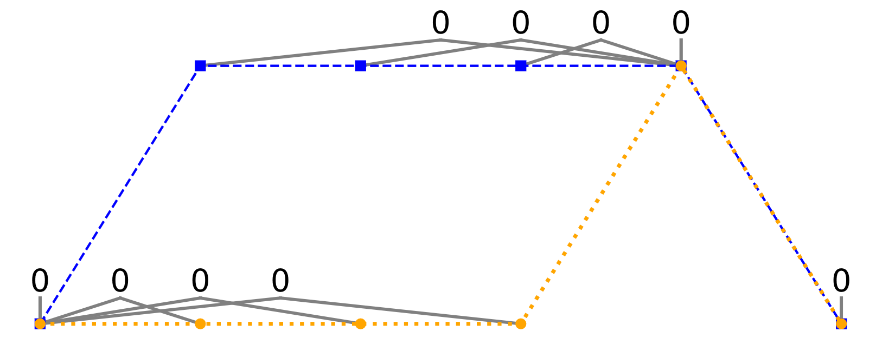
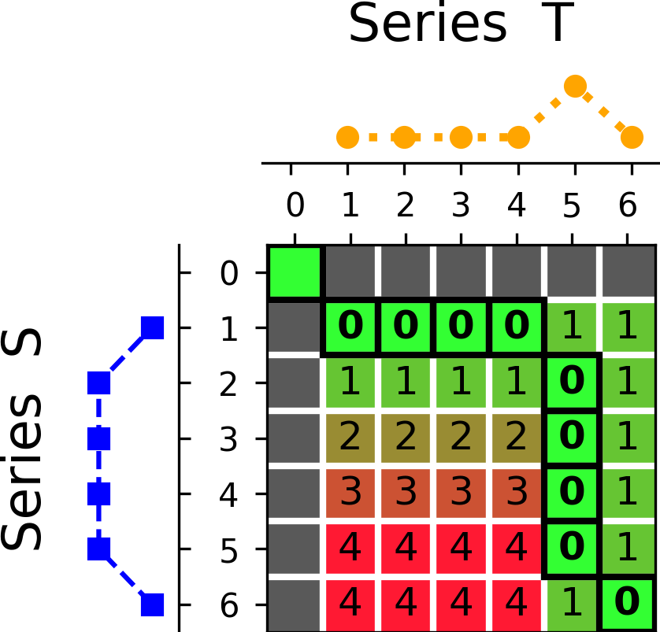
DTW’s warping can be too permissive
DTW = 0

Slide 14
Windowing seeks to control this
Adds further constraint: points cannot be aligned if separated by more than WINDOW time steps
Distance is path with minimum cost that obeys constraints

Slide 15
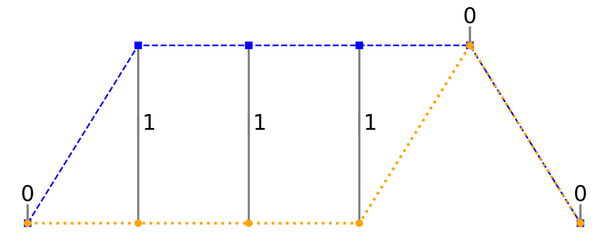
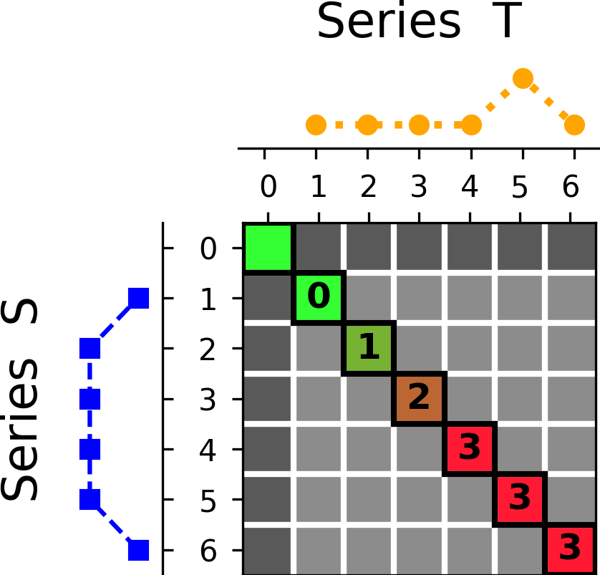
Windowing seeks to control this
Window=0
DTW = 3

Slide 16
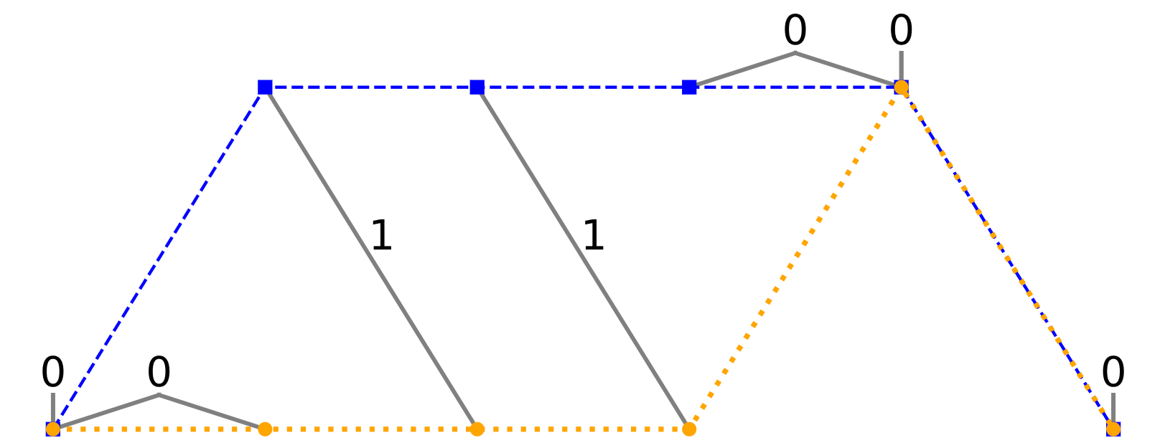
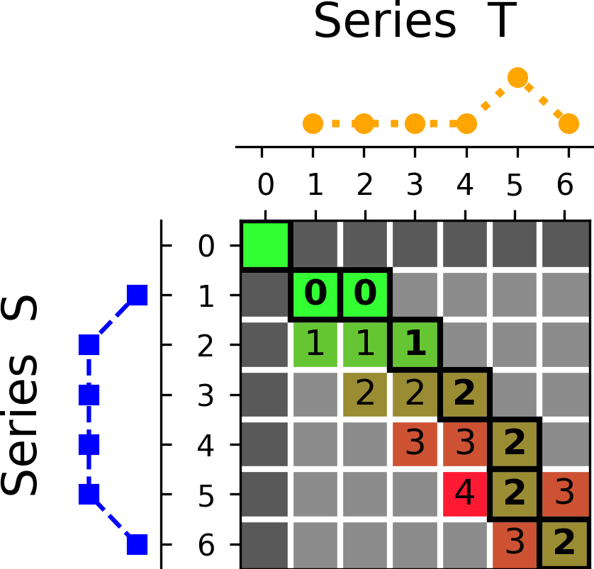
Windowing seeks to control this
Window=1
DTW = 2

Slide 17
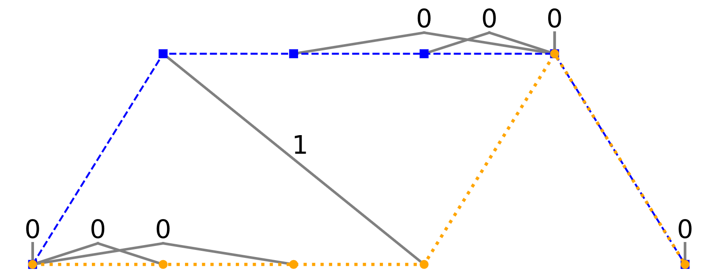
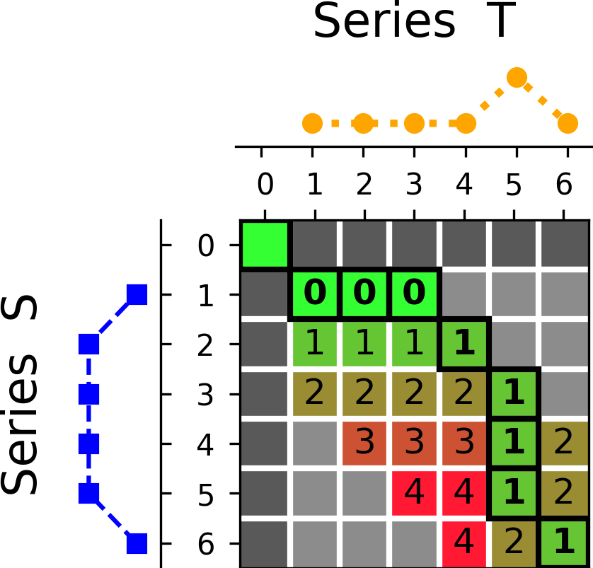
Windowing seeks to control this
Window=2
DTW = 1

Slide 18
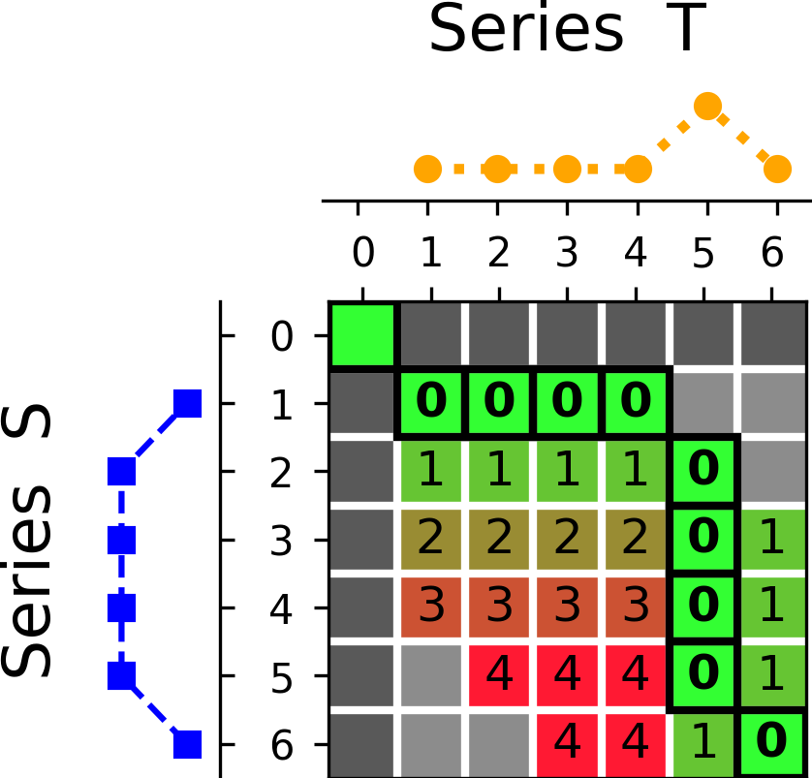
Windowing seeks to control this
Window=3
DTW = 0

Slide 19
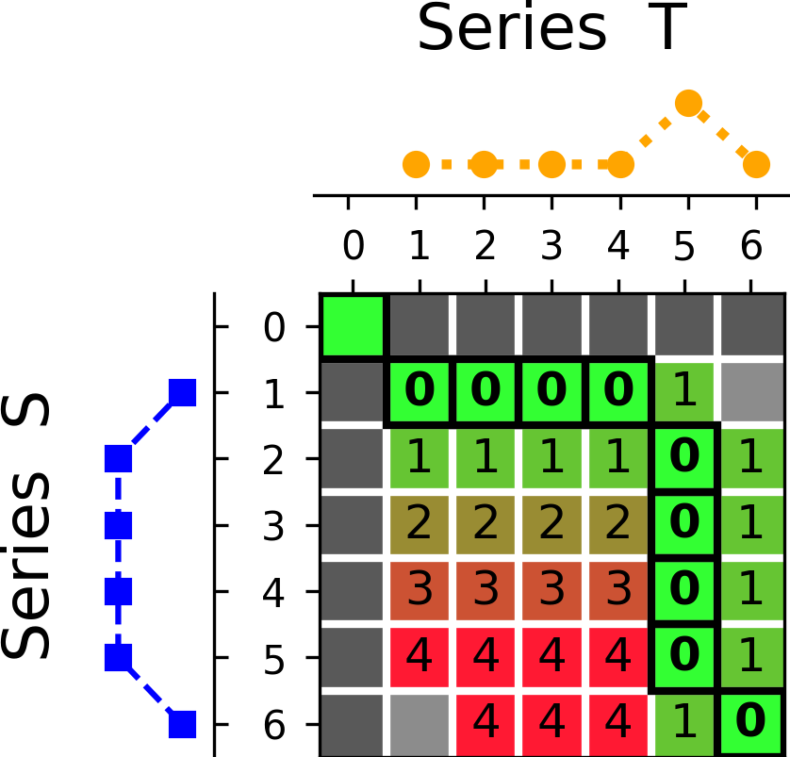
Windowing seeks to control this
Window=4
DTW = 0

Slide 20
DTW variants
Amerced Dynamic Time Warping
Imposes additive penalty for each warping action
Shape Dynamic Time Warping
Scores each alignment of points using information including slope, wavelet transforms and piecewise approximations of the region around the points
Weighted Dynamic Time Warping
Imposes multiplicative penalty based on the distance from the diagonal

Slide 21
Edit Distances
Edit distances are used with discrete series to measure similarity
Peter
Piter
Pioter
Piotr
How similar are the names “Peter” and “Piotr”?
Assume the following cost function
Substitution 1 Unit
Insertion 1 Unit
Deletion 1 Unit
D(Peter,Piotr) is 3
Substitution (i for e)
Insertion (o)
Deletion (e)

Slide 22
Edit Distances for Time Series
There are numerous edit based distances for time series
They move off the diagonal when points are considered different (by some threshold)
They apply an explicit distance penalty for moving off the diagonal
We can relate these to DTW through looking at the options slightly differently

Slide 23
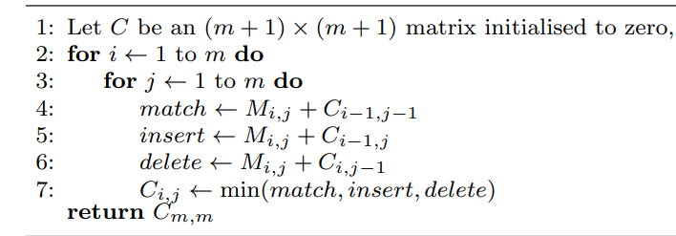
DTW as match/insert/delete
Edit distance approaches apply a penalty for insert/delete

Slide 24
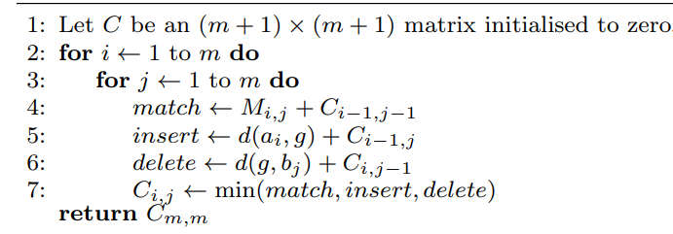
Edit Distance with Real Penalty
DTW
ERP
Pointwise distance to a constant instead

Slide 25
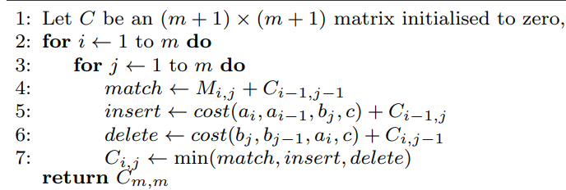
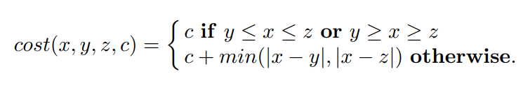
Move/Split/Merge
Move is match, split is insert, merge is delete
MSM
Cost dependent on three values

Slide 26
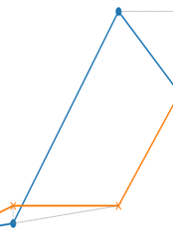
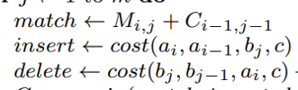
MSM Cost function
DTW uses distance between points on insert/delete
ERP uses distance to a constant on insert/delete
MSM combines these
Suppose a4=3, a5=15, b4=4, b5=4
Cost match(5,5) = |15-4| = 9
Cost insert(5,5) =cost(15,3,4) = 1+9=10
Cost delete(5,5) =cost(4,4,15) = 1

Slide 27
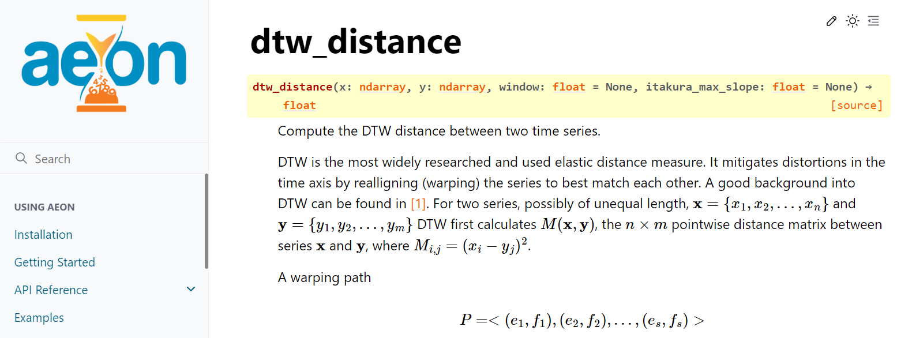
Distance functions in aeon
https://www.aeon-toolkit.org/en/latest/api_reference/distances.html

Slide 28
Distance functions in aeon
Most comprehensive time series distance function library we are aware of
Lightweight implementations in numba
Fully documented
Support multivariate and unequal length
Can generate pairwise matrices between collections
Can extract alignment paths

Slide 29

Distance function support
Name | Univariate | Multivariate | Unequal length
dtw
ddtw
wdtw
wddtw
erp
edr
msm
twe
lcss
euclidean
squared euclidean
manhattan

Slide 30
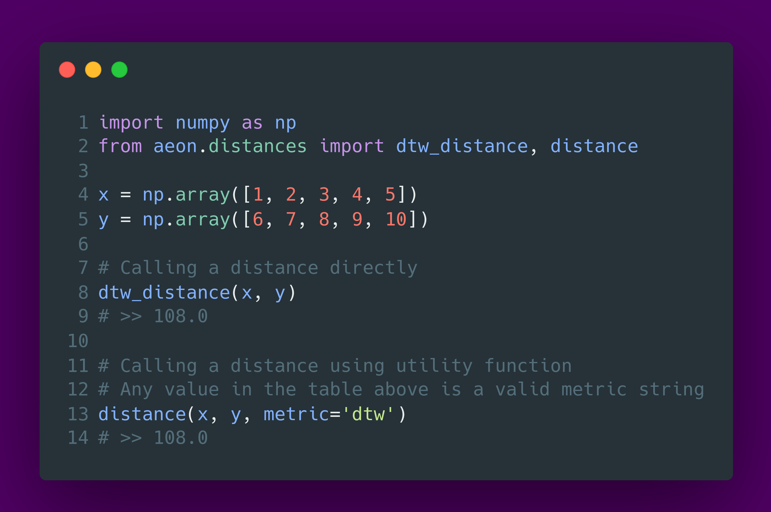
Calling distance functions

Slide 31
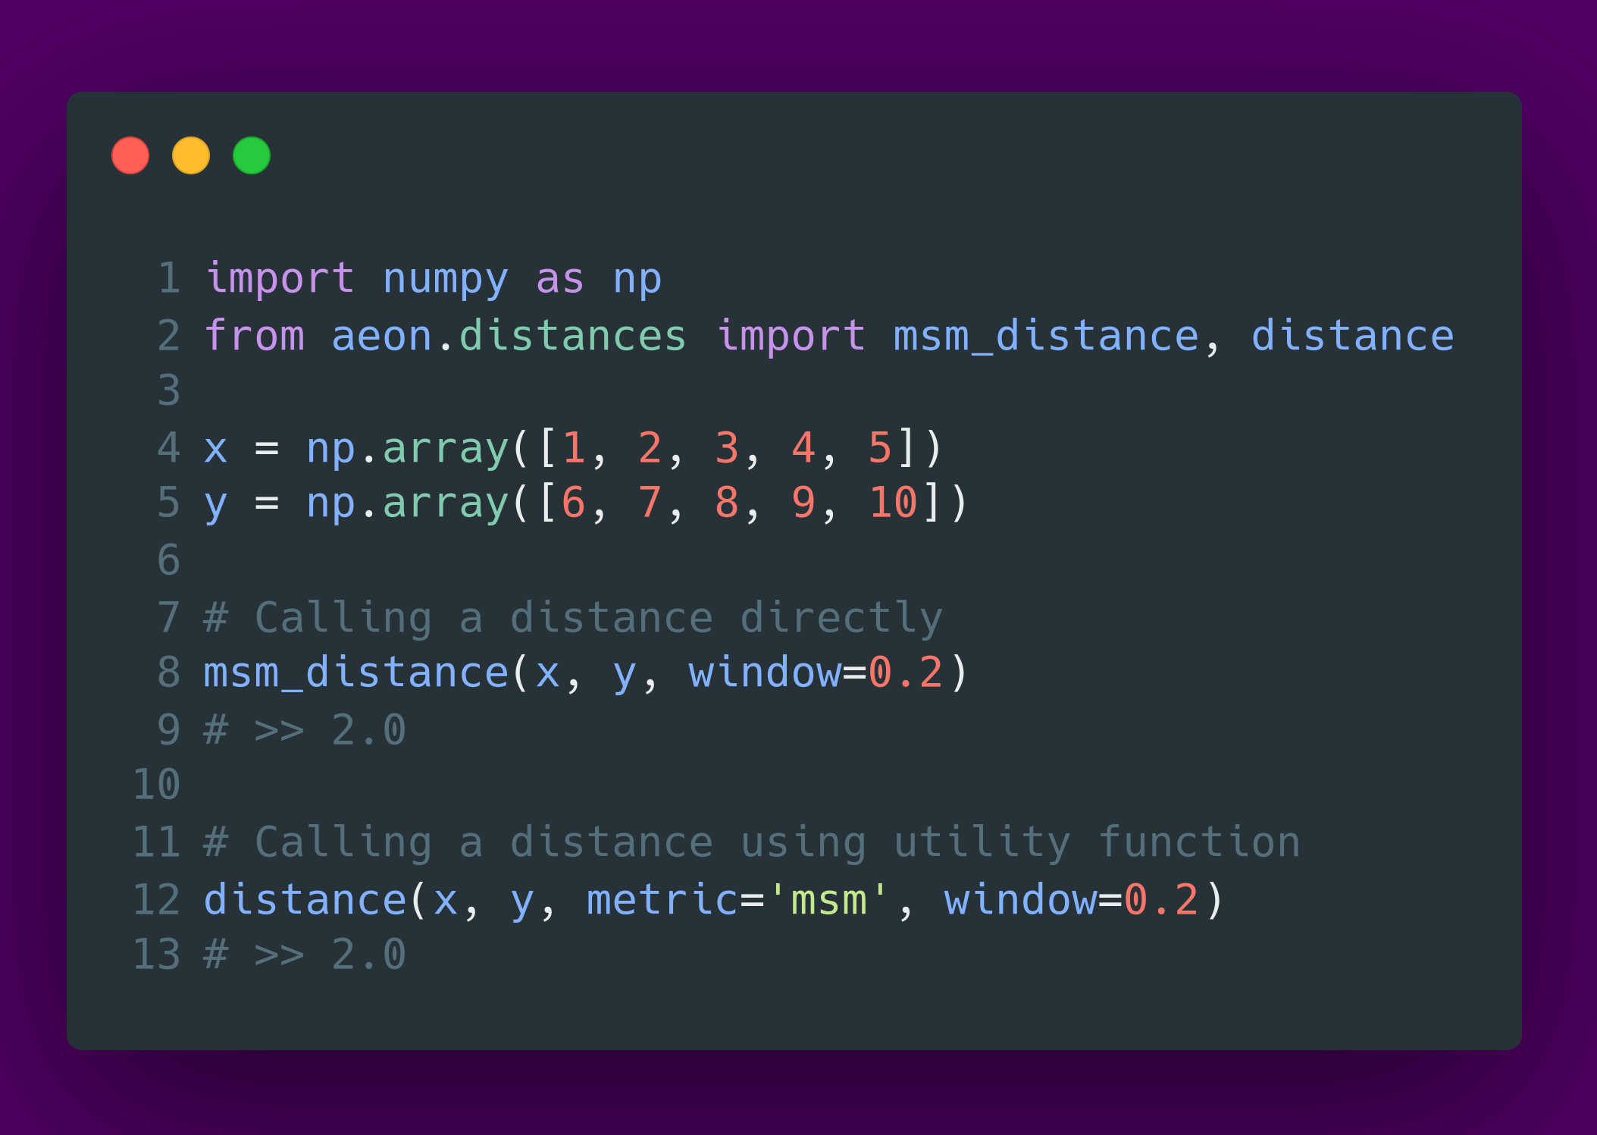
Passing parameters to distance functions

Slide 32
Alignment path

Slide 33
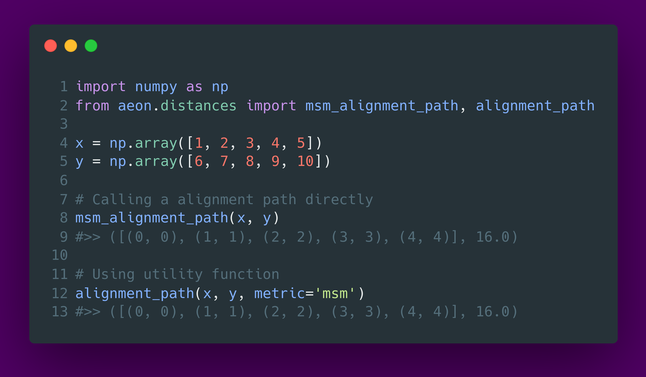
Calling alignment paths

Slide 34
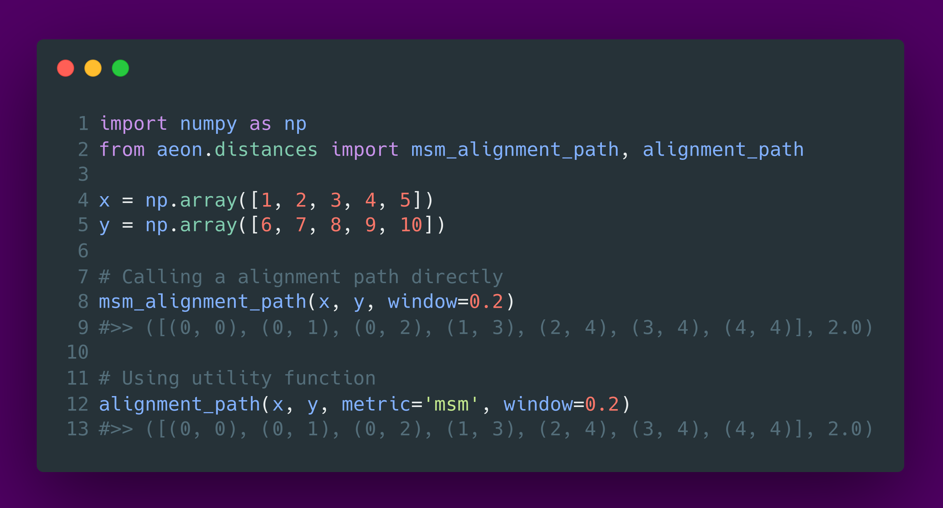
Passing parameters to alignment paths

Slide 35
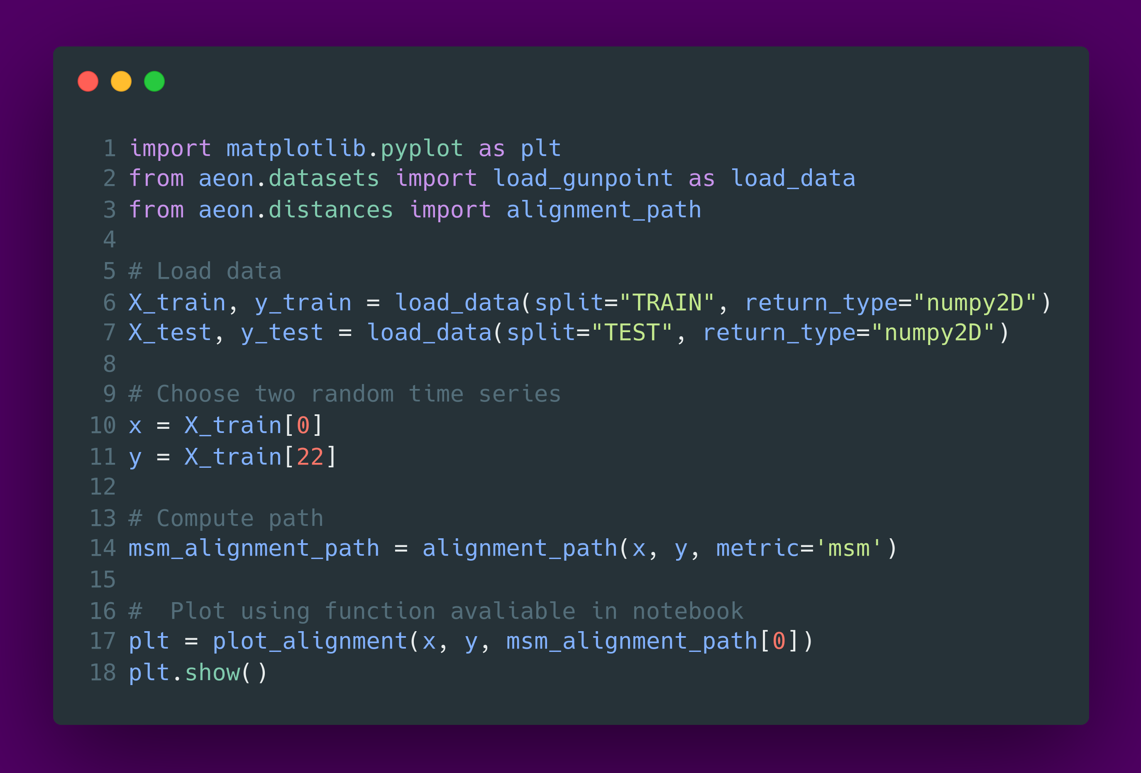
Plot alignment path

Slide 36
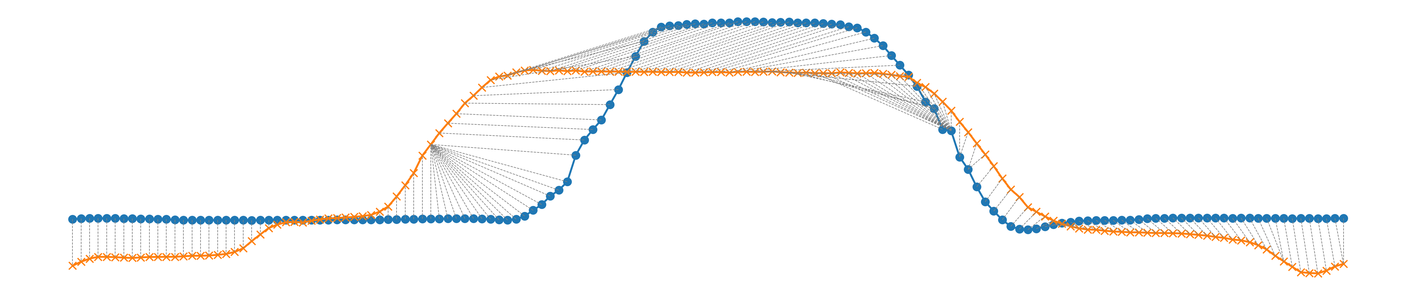
Plot alignment path

Slide 37
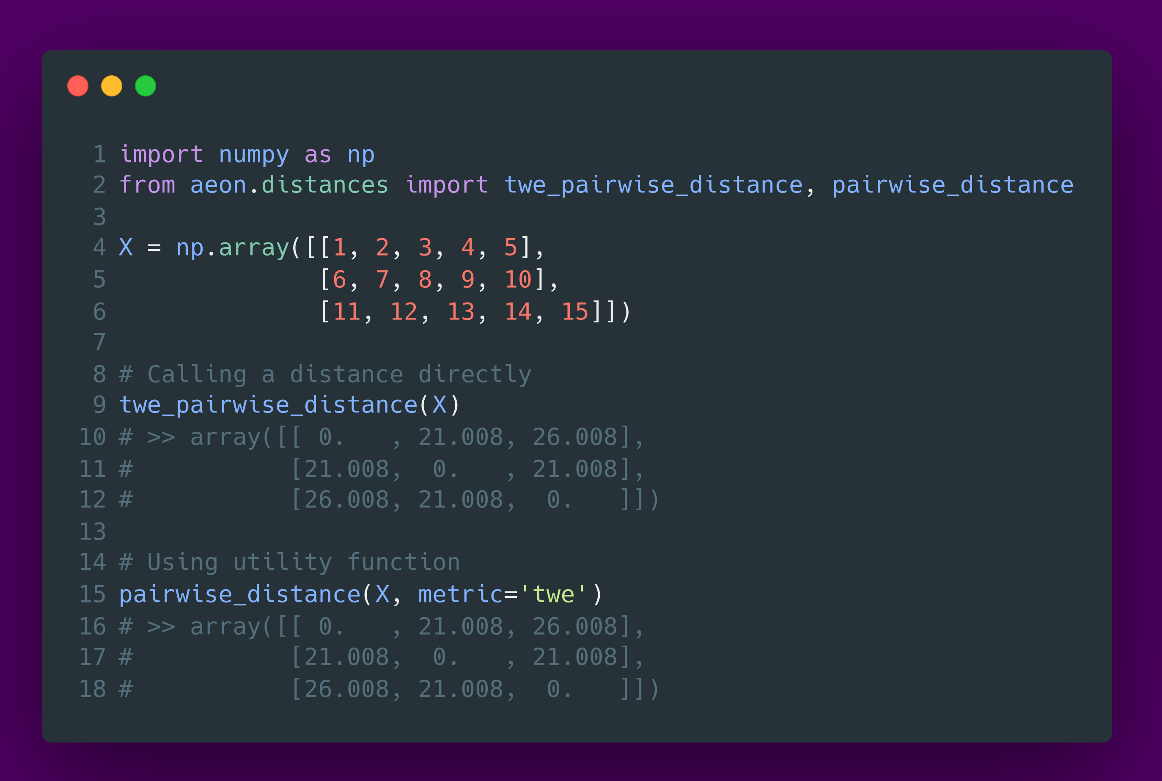
Calling pairwise distance functions

Slide 38
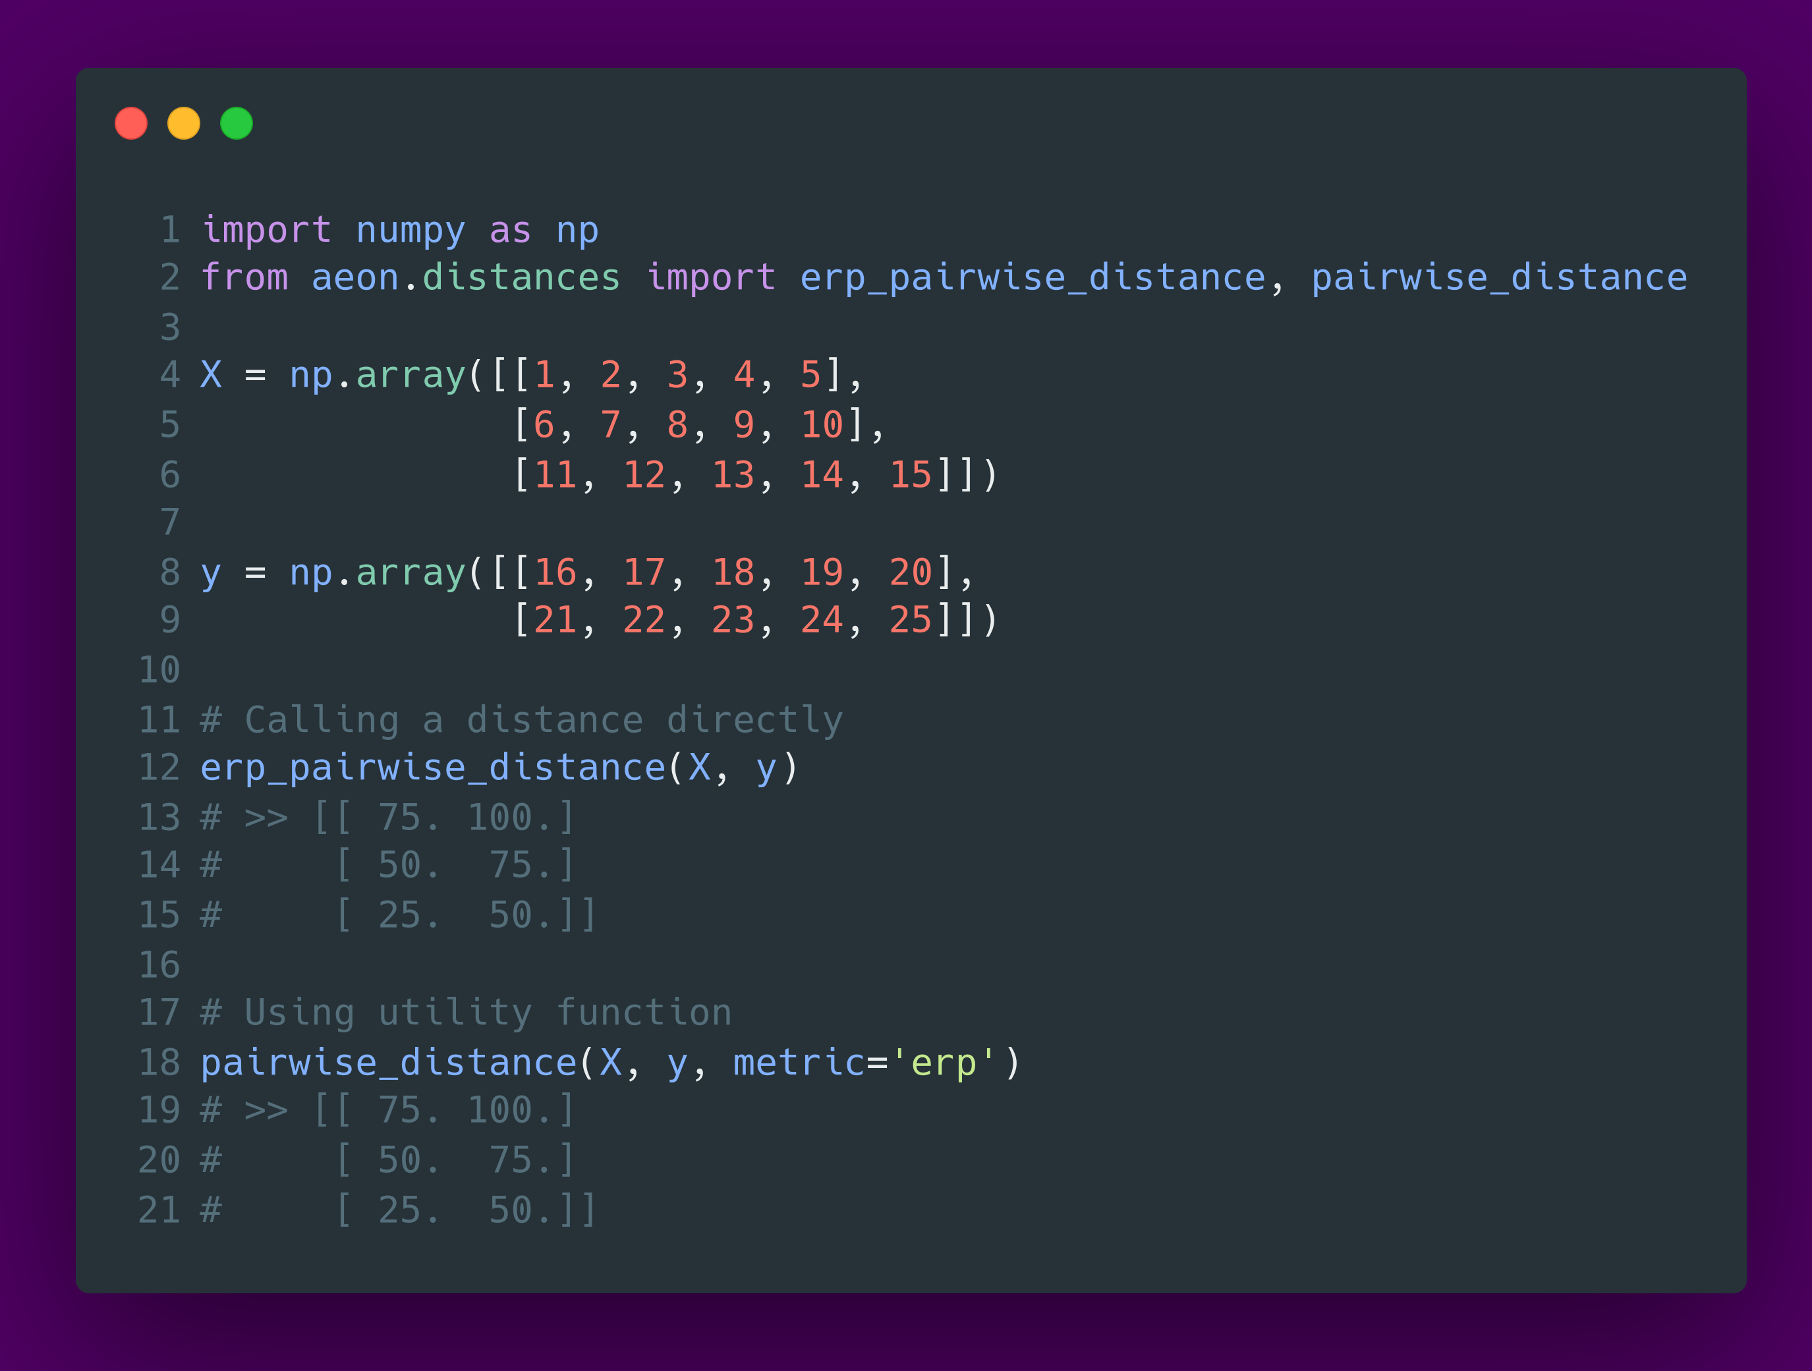
Calling pairwise distance functions

Slide 39
Distance functions with sklearn

Slide 40
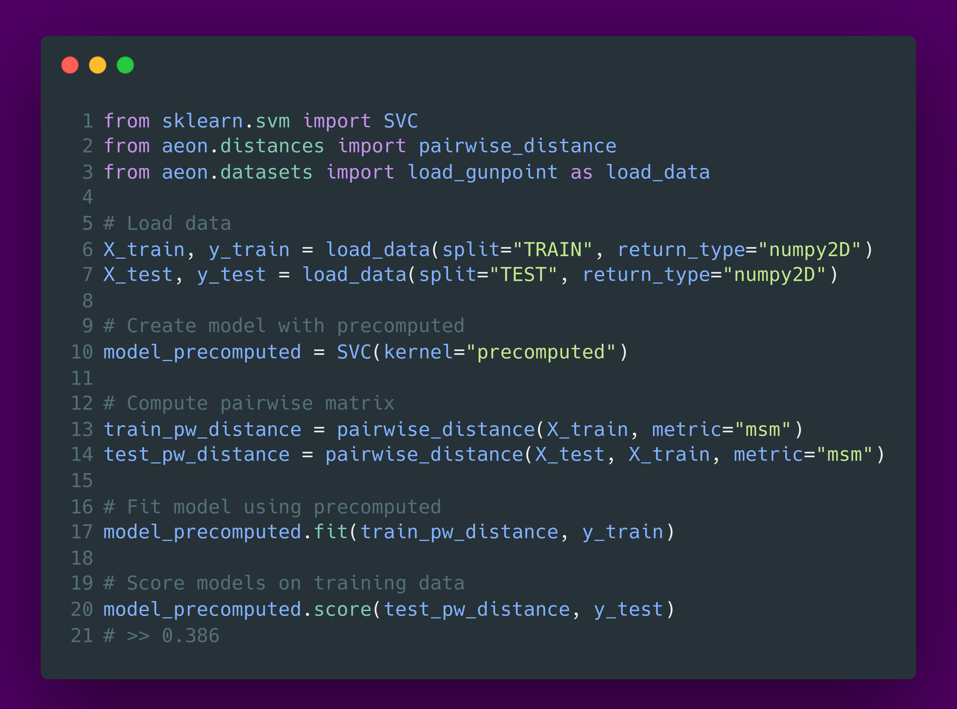
Classification – precomputed distance

Slide 41
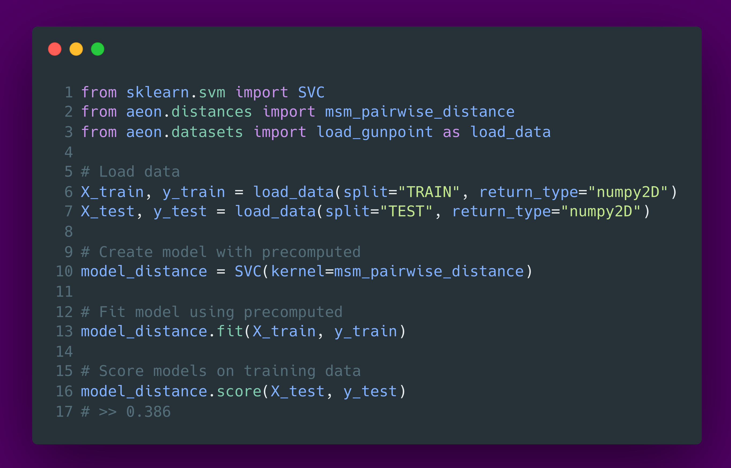
Classification – pass pairwise distance function

Slide 42
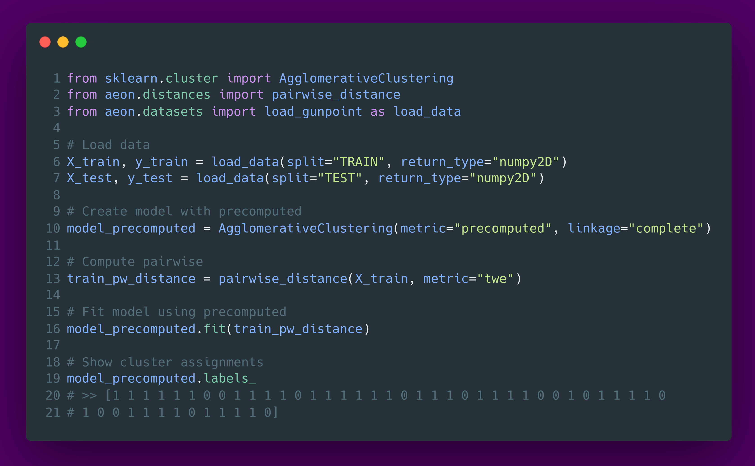
Clustering - precomputed

Slide 43
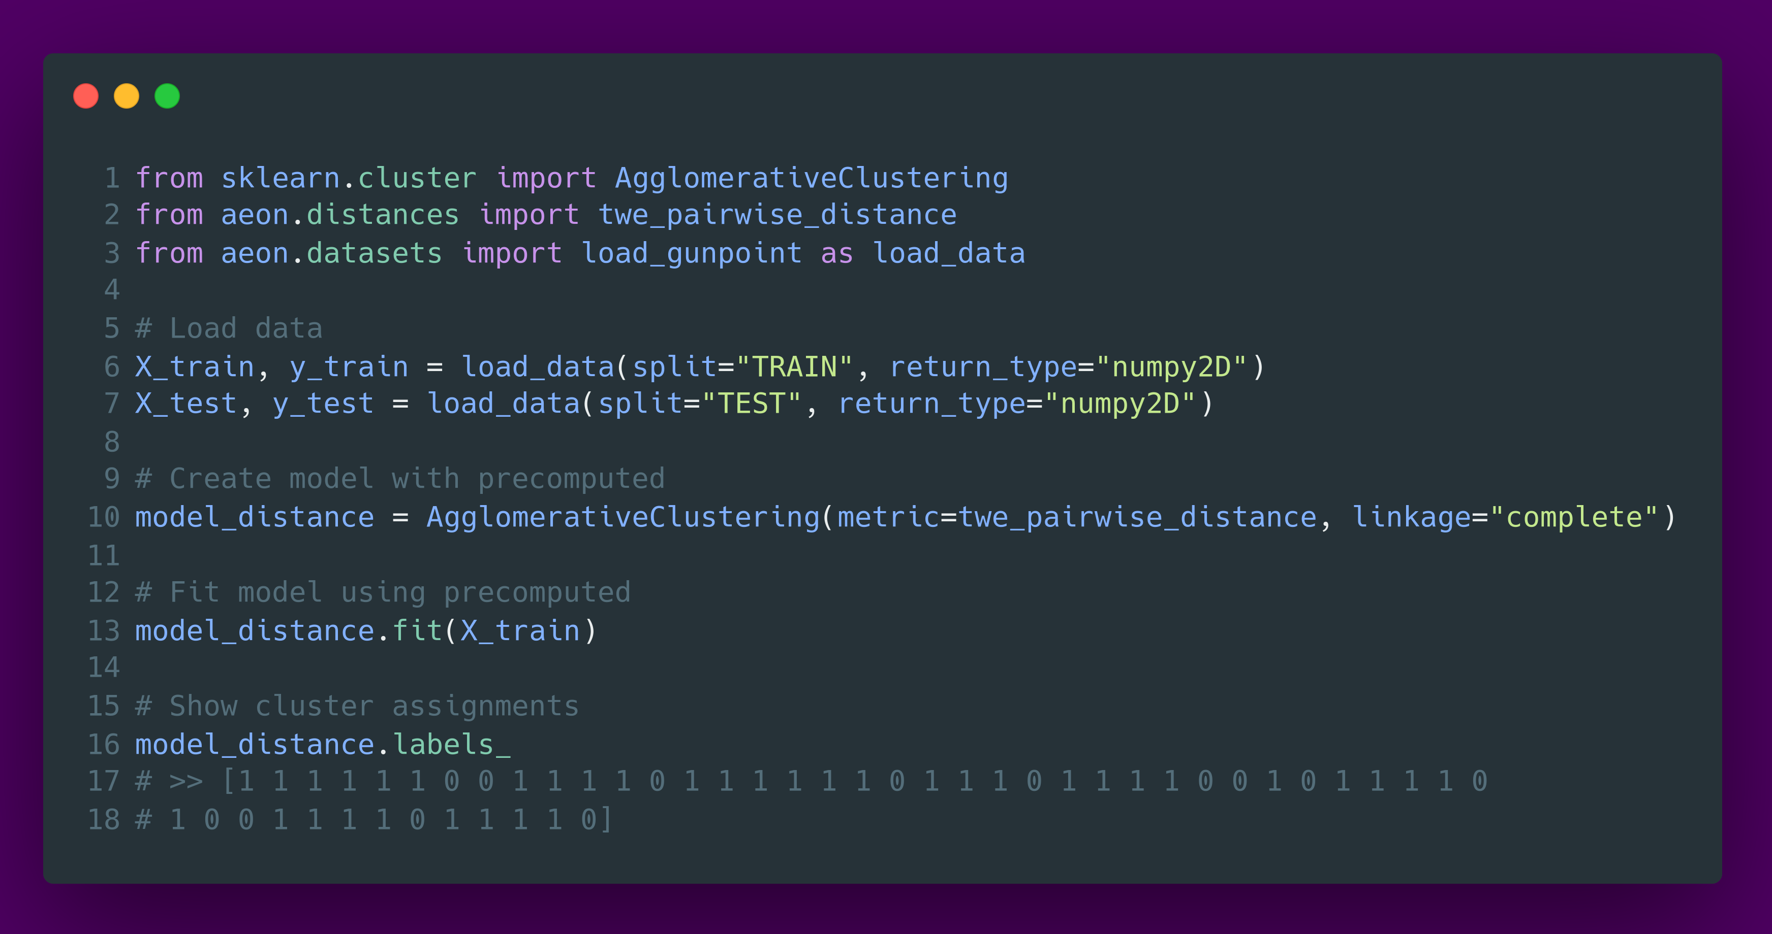
Clustering - pass pairwise distance function

Slide 44
Why do we need bespoke clusterers?
sklearn clusterers only compatible with precomputed or pairwise, and not compatible with multivariate time series
Hard coded checks for data and distances in both clustering and classification
No medoid based clustering

Slide 45
Clustering in aeon
sklearn clusterers only compatible with precomputed or pairwise, and not compatible with multivariate time series
Hard coded checks for data and distances in both clustering and classification
No medoid based clustering
K-Means configurable for distances and barycentre averaging
K-Medoids configurable to use either Lloyds or Partitioning Around the Medoids
PAM extensions CLARA and CLARANS

Slide 46

Applications: Time Series Clustering (TSCL)
https://link.springer.com/article/10.1007/s10115-023-01952-0

Slide 47
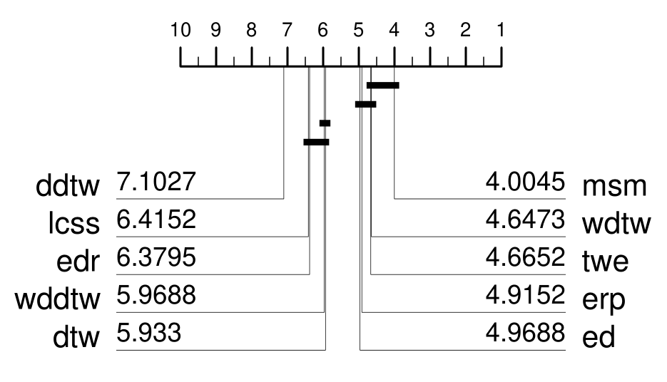
Comparison of different distance functions for k-means TSCL
The CD is for accuracy. Results with other measures in the paper
MSM only algorithm significantly better than Euclidean distance
DTW significantly worse than Euclidean distance!

Slide 48
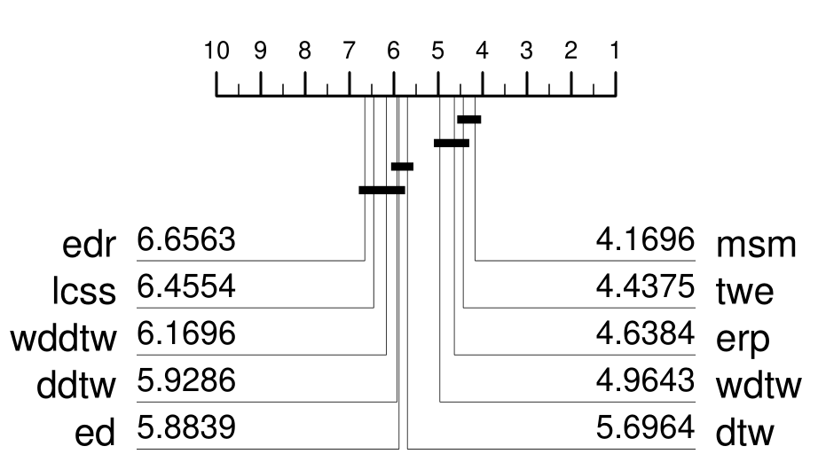
Comparison of different distance functions K-medoids TSCL
K-means averages to find centroids. An alternative is to use medoids as centres (members of the cluster)
DTW not worse than Euclidean distance using medoids
Distances with explicit warp penalty all better than Euclidean distance

Slide 49
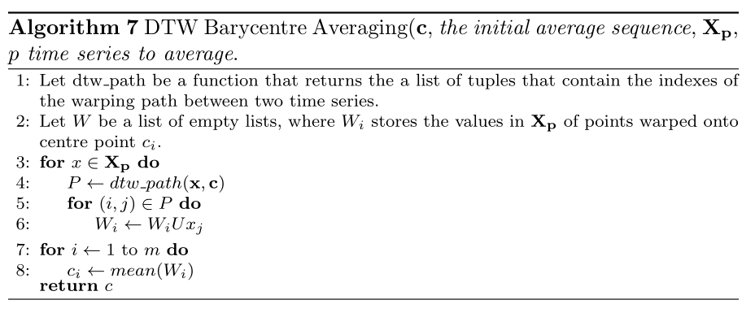
Barycentre Averaging (DBA) [4] for K-Means
K-means averages to find centroids. An alternative is to warp cluster members onto each other.
Find centroids by averaging
over realigned values

Slide 50
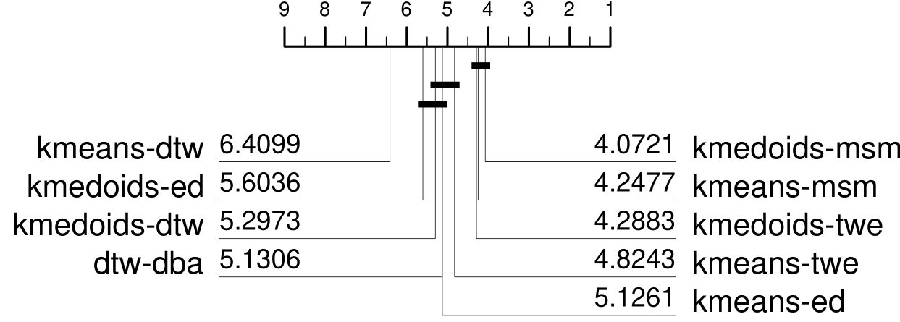
Comparison of DBA, k-means and k-medoids
Clear top clique of three algorithms
dba significantly improves DTW

Slide 51
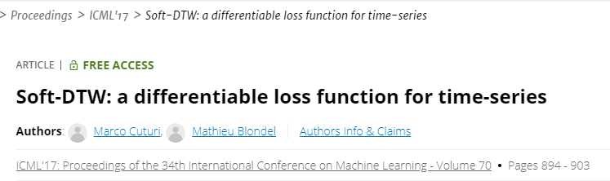
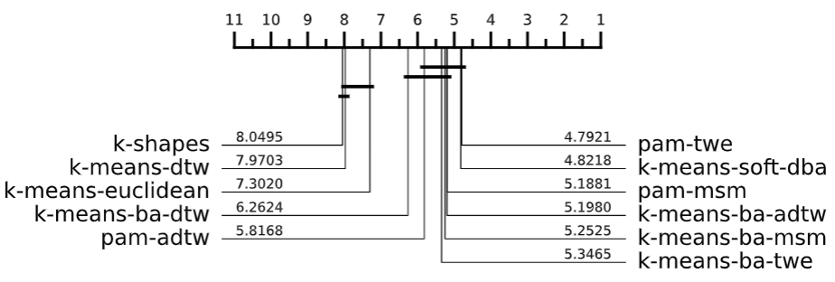
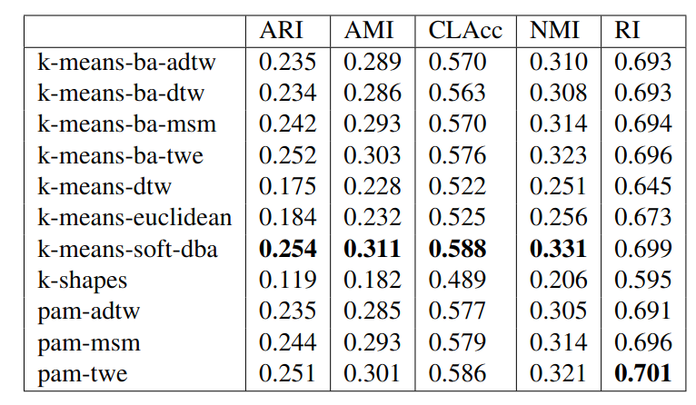
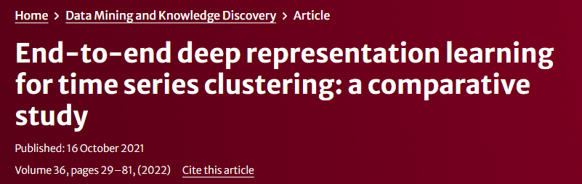
Current state of play with distance based
tslearn wrappers
The best deep learning approach in [1] of the hundreds assessed, a CNN with joint pretext loss and without clustering loss achieved an average NMI of 0.3292

